Slide 1
Transformer
AI ToolKit
Fall Semester, 2023
Reference from http://jalammar.github.io/illustrated-transformer/
Notes:
How can summarize matrices, how matrices can be decomposed.

Slide 2

Transformer
A model that uses attention to boost the speed
Outperformed the Google Neural Machine Translation model in specific tasks
A benefit in parallelization, long-term dependency.

Slide 3
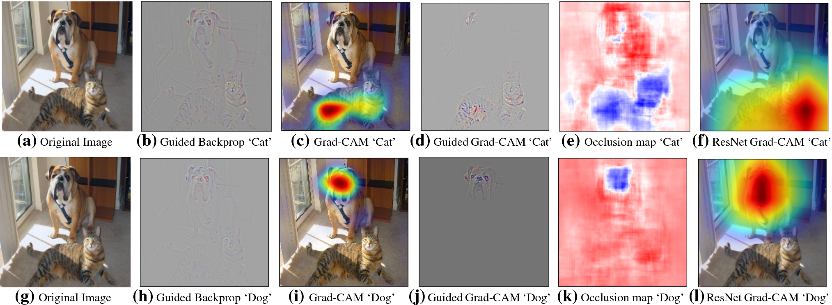
Transformer : attention?
The information of “where to look” more
Image Credit: original paper of Grad-CAM

Slide 4
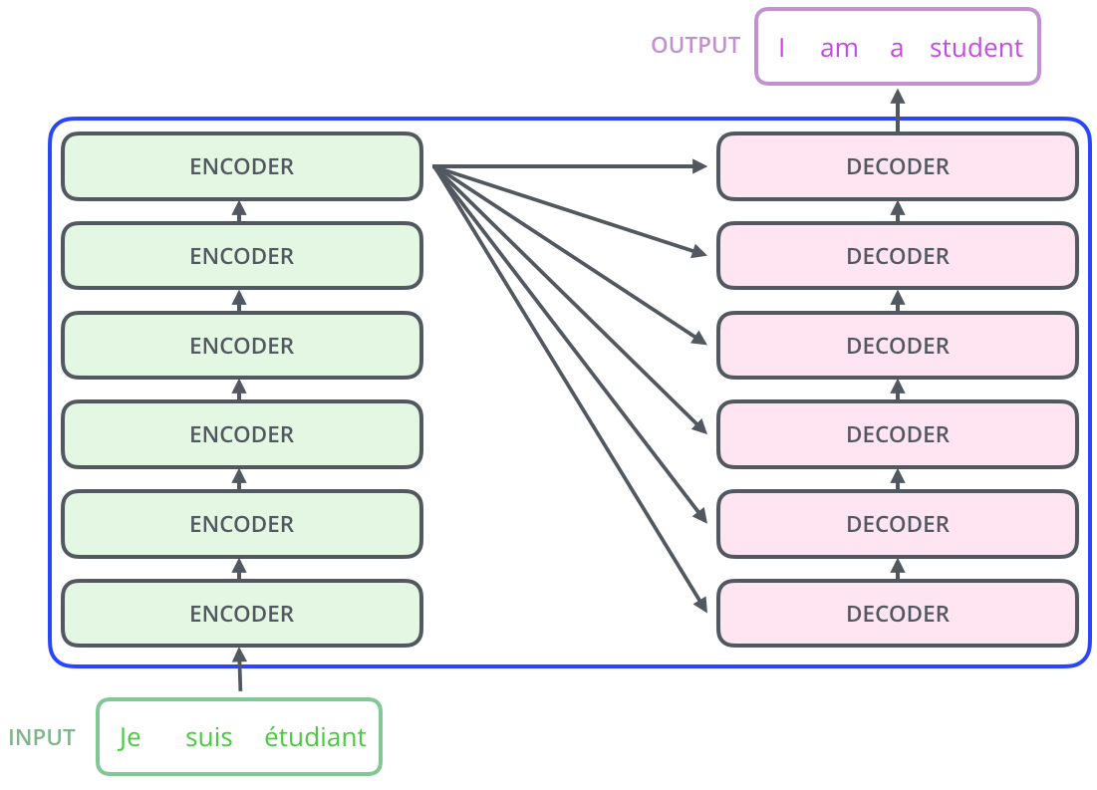
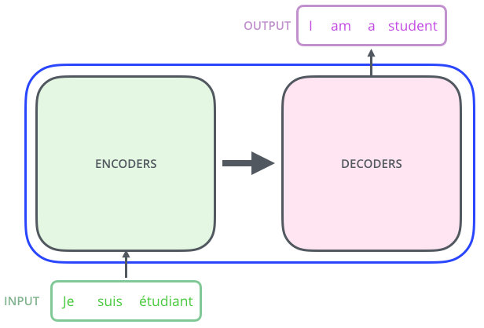

Transformer : structure

Slide 5
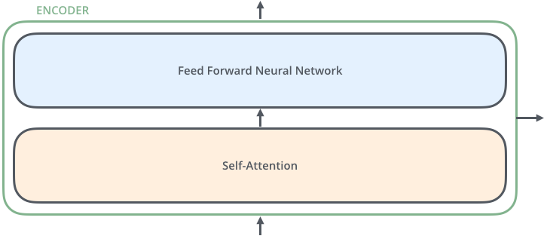
Transformer : encoder
Self Attention Layer
: A layer that helps the encoder look at other words in the input sentence, when encoding a specific word.

Slide 6

Transformer : encoder + decoder
Encoder-Decoder Attention
: An attention layer that helps the decoder focus on relevant parts of the input sentence

Slide 7
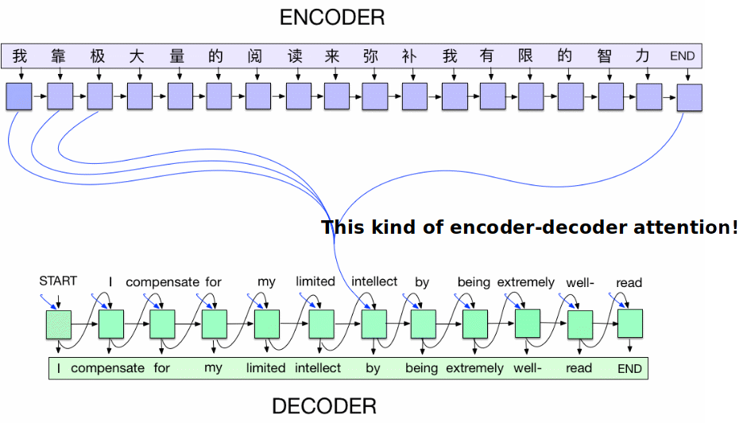
Transformer : encoder + decoder

Slide 8
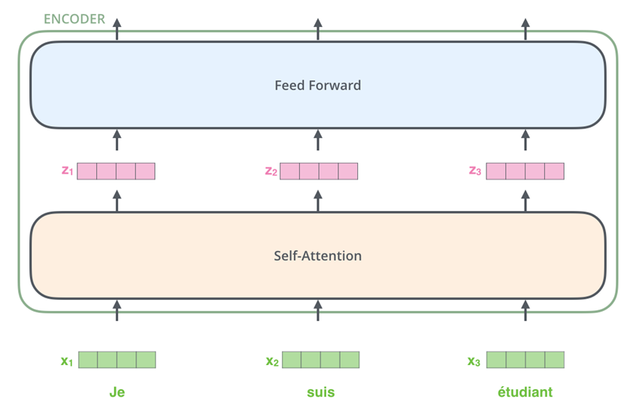
Transformer : encoder

Slide 9
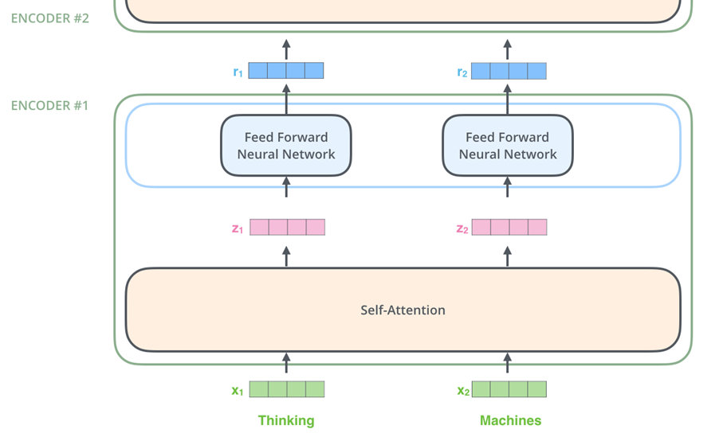
Transformer : encoder

Slide 10

Encoder: Self-Attention
Think about the sentence
“The animal didn’t cross the street because it was too tired”
Self-attention is the method the Transformer uses to bake the “Understandings” of other relevant words into the one we are currently processing

Slide 11



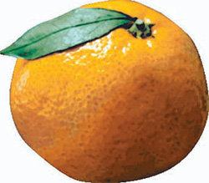

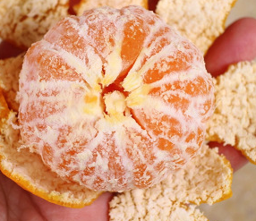




Query, Key, Value, and Attention
Query
Key
Value
??

Slide 12

Query, Key, Value, and Attention
Query
Key
Value
??

Slide 13
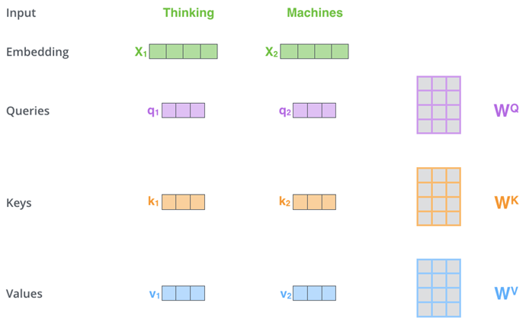
Encoder: Self-Attention
Calculate three vectors from each of encoder’s input vectors
Query, Key, Value

Slide 14
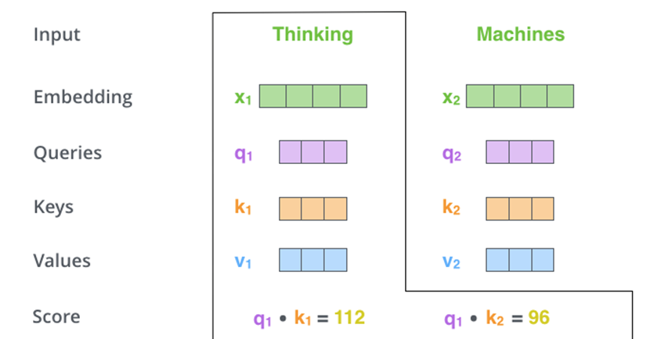
Encoder: Self-Attention
Calculate a score of the input sentence against the target word.
The score determines how much focus to place on other parts of the input sentence as we encode a word at a certain position.

Slide 15
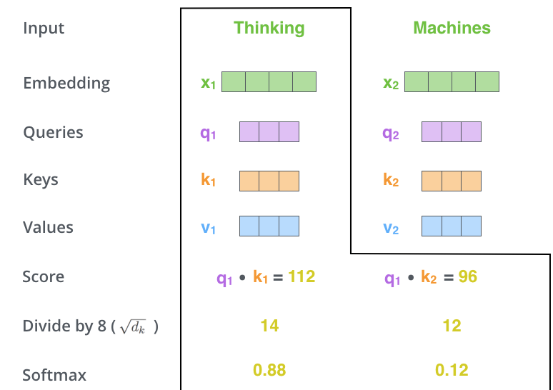
Encoder: Self-Attention
Divide the score by 8 (The square root of the dimension of the key vectors), and pass it to the softmax function.

Slide 16
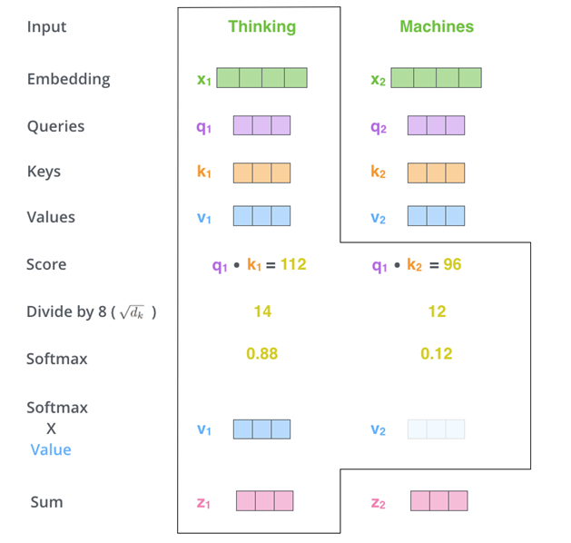
Encoder: Self-Attention
Multiply each value vector by the softmax score and sum up the weighted value vectors.

Slide 17
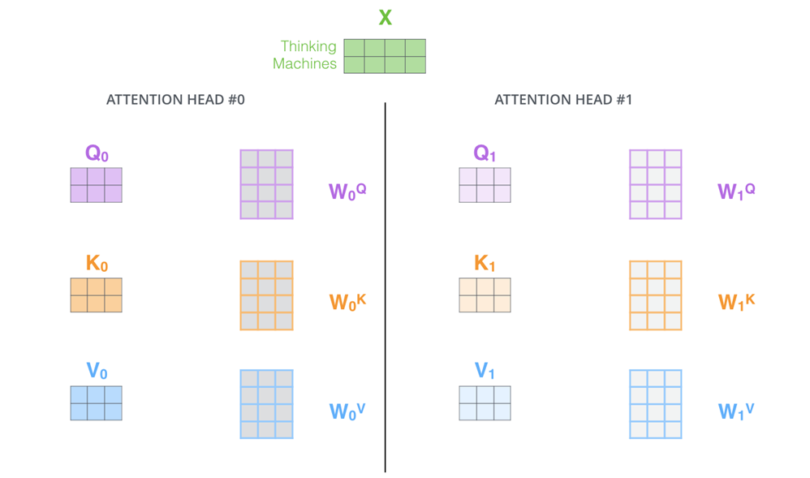
Encoder: Multi-headed Self-Attention

Slide 18
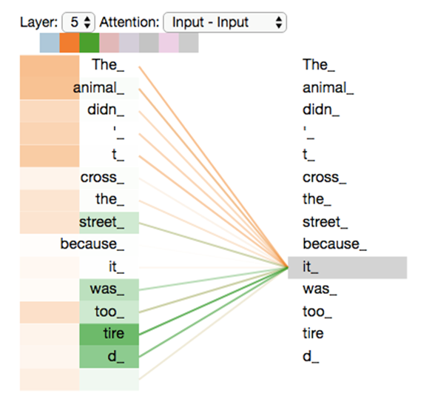
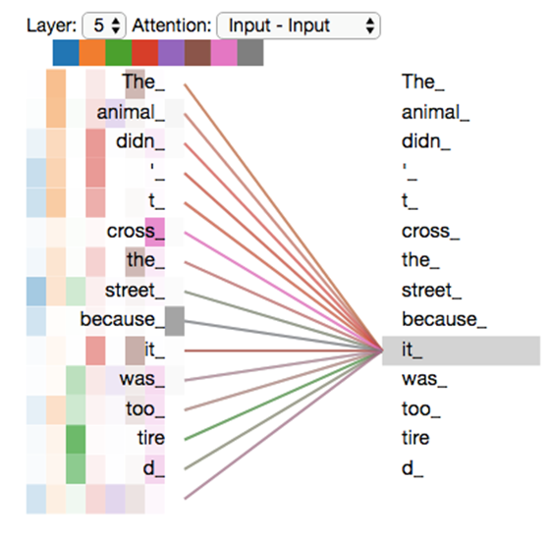
Encoder: Multi-headed Self-Attention

Slide 19
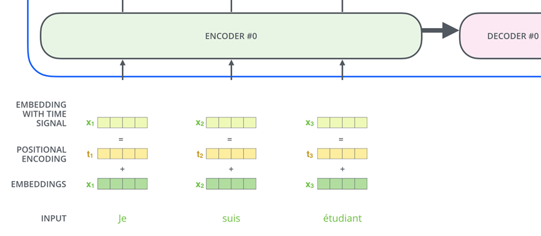
Encoder: Position Encoding
In order for the model to make use of the order of the sequence, the information about relative or absolute position of the tokens in the sequence needs to be injected

Slide 20
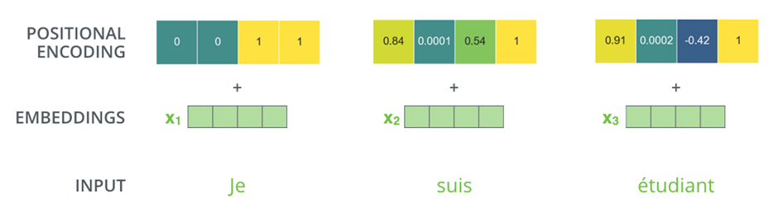
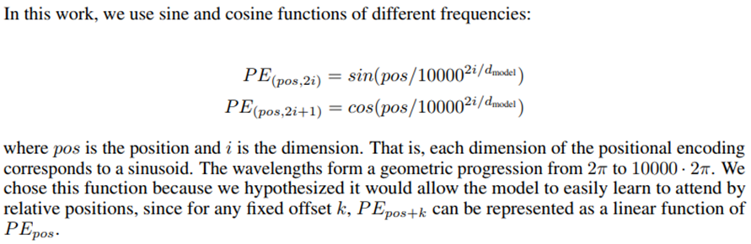
Encoder: Position Encoding

Slide 21
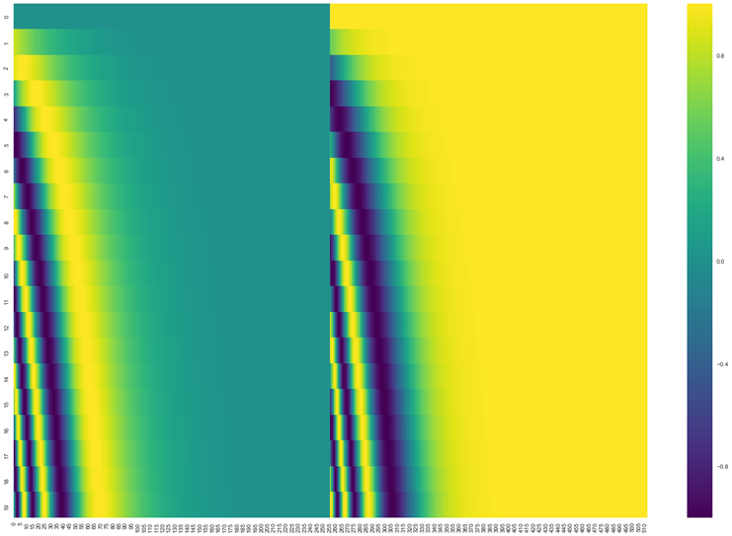
Encoder: Position Encoding
The real example of positional encoding for 20 tokens/words (rows) with embedding size of 512 (columns)

Slide 22
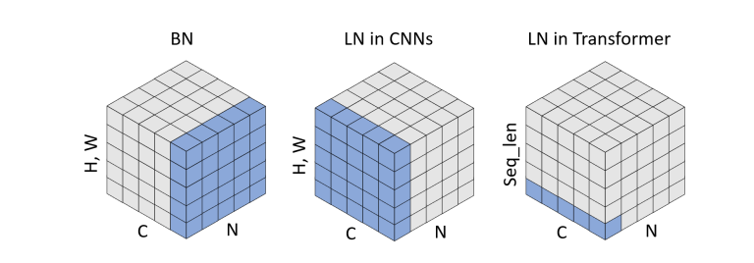
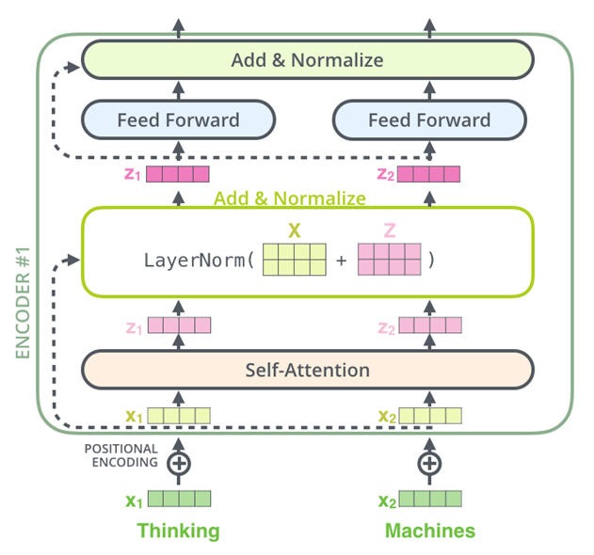
Encoder: The residuals & layer normalization
Image Credit: https://openaccess.thecvf.com/content/ICCV2021W/NeurArch/papers/Yao_Leveraging_Batch_Normalization_for_Vision_Transformers_ICCVW_2021_paper.pdf

Slide 23
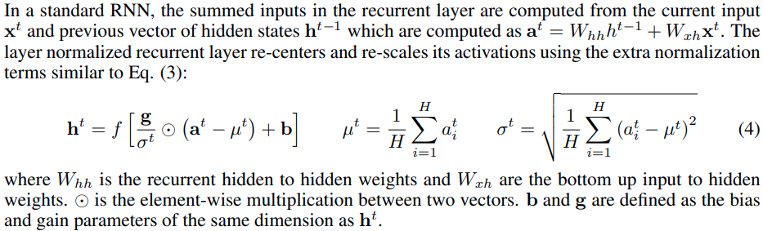
Encoder: The residuals & layer normalization

Slide 24
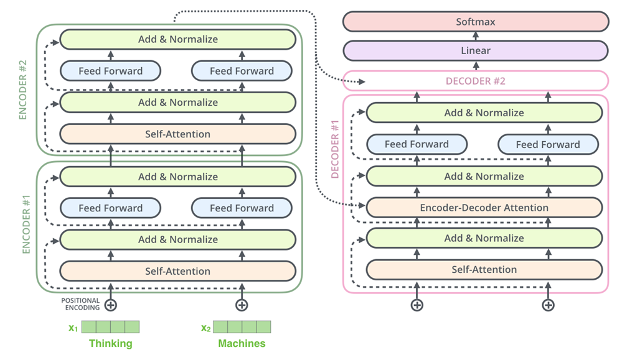
Encoder: The residuals & layer normalization

Slide 25

Decoder: encoder-decoder attention

Slide 26

Decoder: encoder-decoder attention

Slide 27
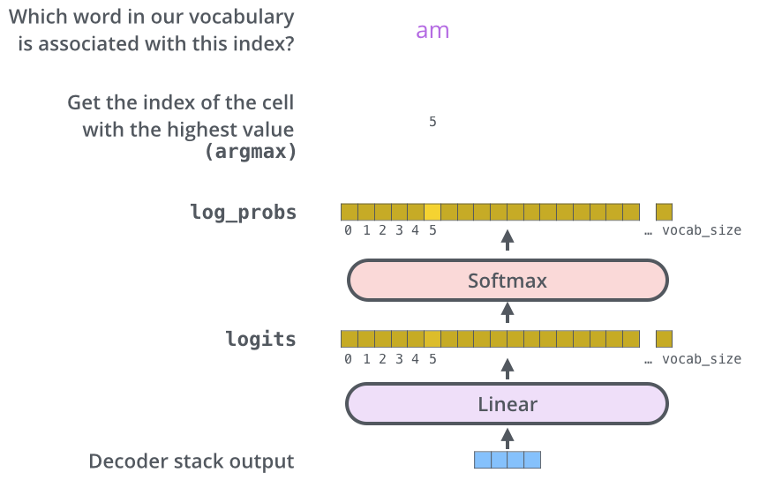
Decoder: the final layer and softmax layer

Slide 28
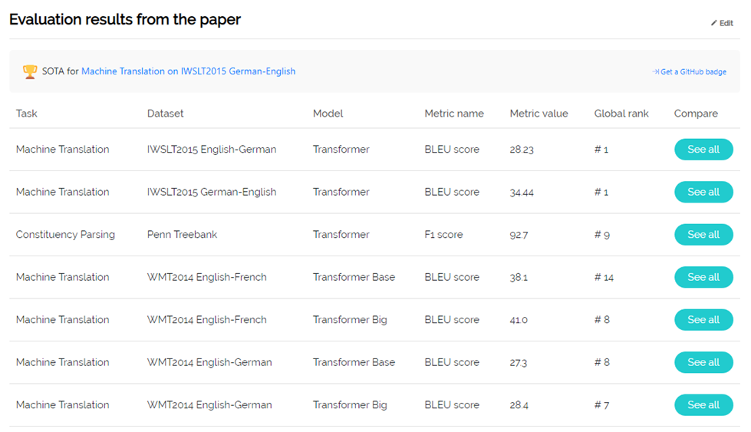
Conclusion

Slide 29
Any Questions?

